Slide 1
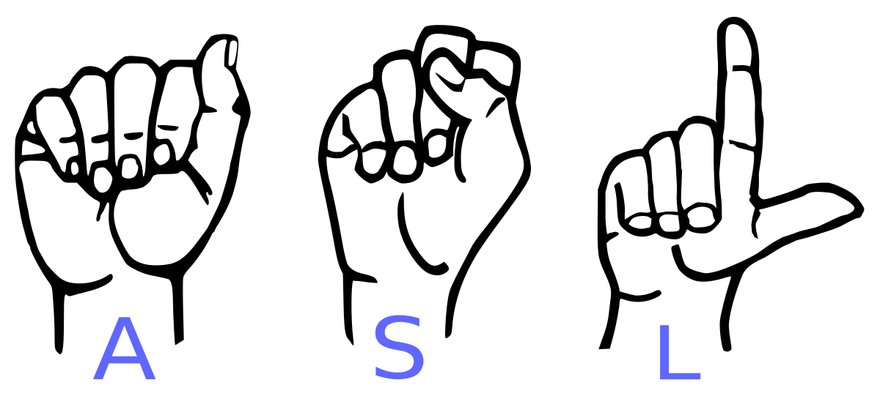
Real Time Sign Language Interpreter
Akshit shah
Vijoy sunil Kumar
Vikhyat goyal

Slide 2
Introduction
Bridge the communication gap between normal and differentially abled people.
The system we propose is based on translating gesture into text. It suggests an approach involving sign language recognition via a computer processor that assimilates these gestures and signs to produce their equivalent characters.

Slide 3
Block Diagram
BACKGROUND SUBTRACTION
CONTOUR & THRESHOLD
CAMERA
IMAGE PROCESSING
Logitech C200
LOOK UP MATCHING LETTER
DISPLAY
A
KEYBOARD
TRAINING
JETSON TK1

Slide 4
Flow Diagram
THREAD #1
THREAD
#2
THREAD
#3
THREAD
#4
THREAD #5
BACKGROUND
SUBTRACTION
IMAGE
CAPTURE
CONTOUR
CONTOUR MATCHING
DISPLAY LETTER
5
1
2
3
4
5
: SEMAPHORES

Slide 5
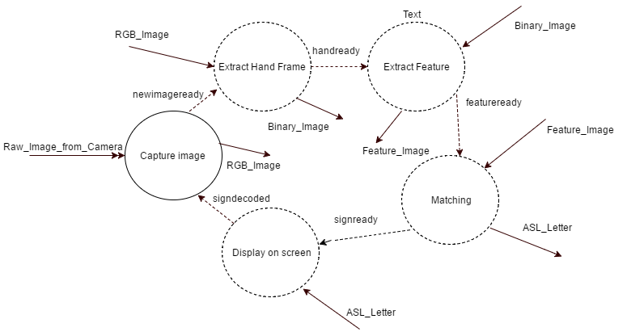
CFD

Slide 6
Real time services
1. Capturing the image
2. Extracting Hand (Background Subtraction)
3. Extract Feature (Contour and thresholding)
4. Match the extracted hand with the database
5. Display the output
Training the system.

Slide 7
Capability requirements
The system should have a feature to allow users to train the system so that it can be used for different sign languages.
The camera should capture images and it shall be processed by the Jetson TK1 and information(hand) shall be extracted by the frames.
The Hand should be inside the designated frame space.

Slide 8
Real time requirements
The system should be able to decode the sign with maximum accuracy within 330 msec.
Use semaphores to synchronize the threads
The system should use RM policy for achieving a fixed priority scheduling
(Capturing image -> highest priority)
(Displaying character -> least priority)
The service “th1_captureimage” should flush the camera buffer on every call and discard all the frames but the last one to achieve a faster performance and remove the lag created by the ‘vediocapture()’ OpenCV buffers.

Slide 9
Performance requirements
Quick response
Produce the output within a real-time deadline to properly comprehend the actions.
Error free recognition of the letters will require all threads to complete before the system deadline.
The time period of the system is sum of time period of all services. This implies every service should be executed exactly once within this time period.
Protection against data corruption using semaphores

Slide 10
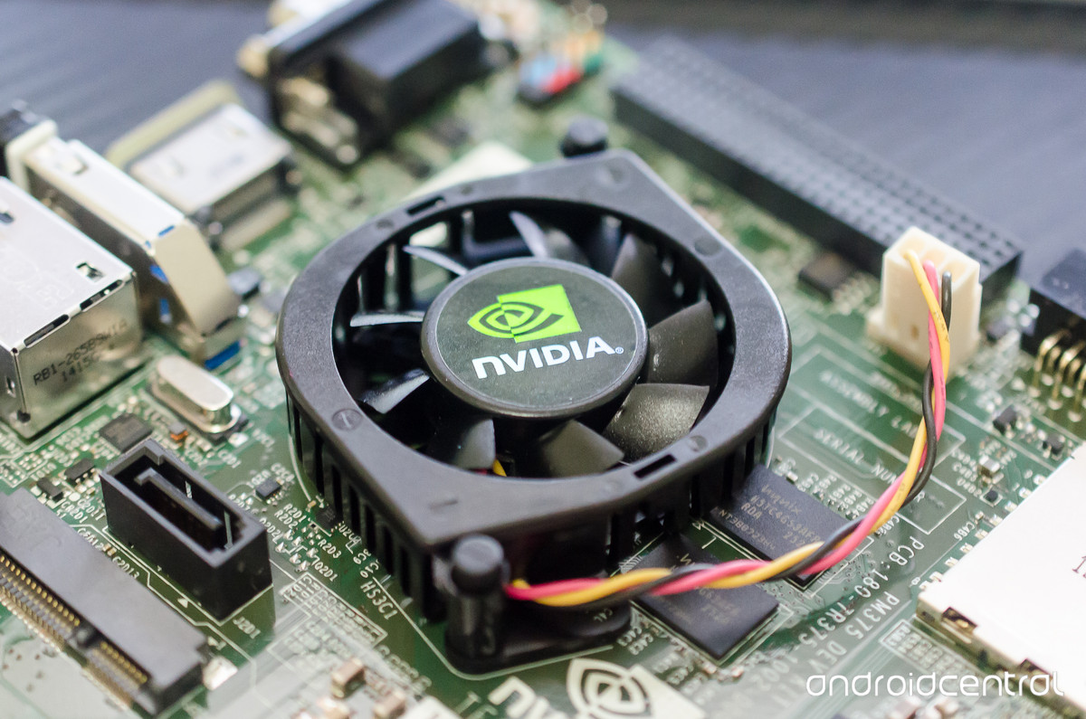
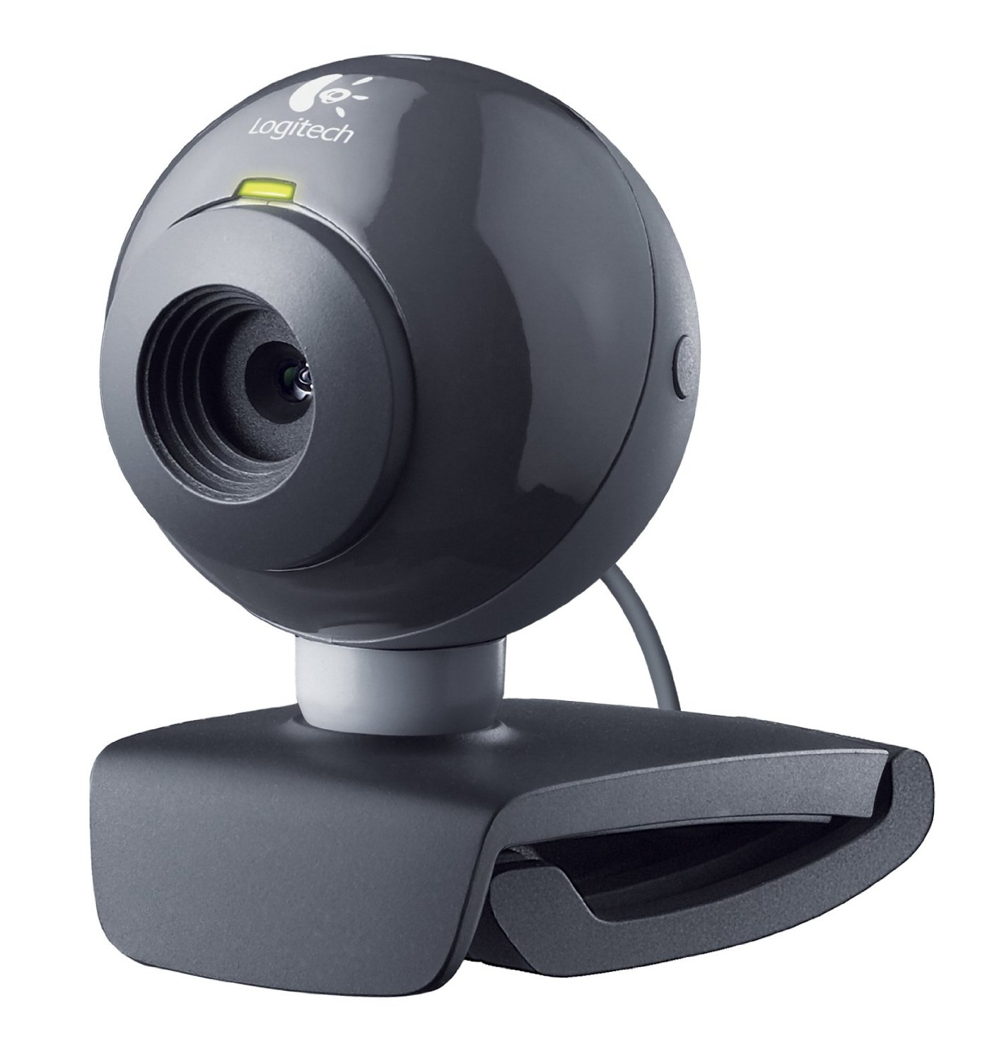
Proof of concept Implementation
Platform resources
NVIDIA Jetson TK1
Logitech C200 USB camera

Slide 11
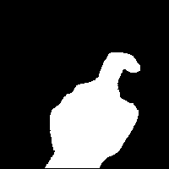

Proof of concept Implementation
Hand extraction using MOG2 background subtraction
It was observed that the system could extract the new object with perfection and a reset after 10 frames was a fast and good solution to shield against changing backgrounds.
Updated to perform a flush of the preloaded frames from the buffer to achieve a more predictable and real-time behavior.
Notes:
This along with the thread schedule feasibility experiment and cheddar tool simulation were used as proof-of-concept.

Slide 12
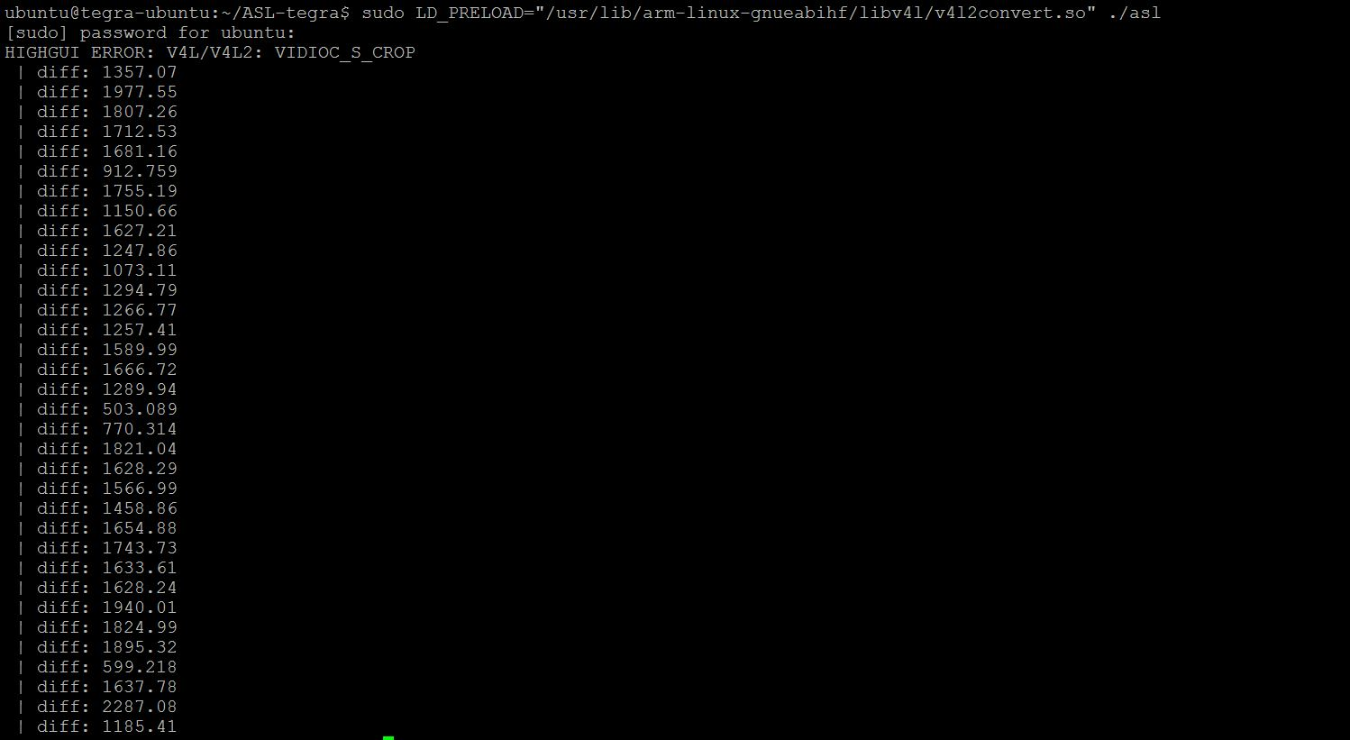
Proof of concept Implementation
Sign identification using Hausdroff distance
Maps the vector distance between the sample set and a preloaded test image to find the best match.
A comparison with the histogram matching algorithm showed that the system works better with hausdroff algorithm and hence, this was chosen as the matching algorithm for our system.

Slide 13
WCET safety margin
Service | Safety Margin
Capture Image | Calculated based on the longest amount of time taken among the first 100 execution instances.
Extract Hand | The longest path taken by this service is when there is too much noise in the background and the background subtraction function resets the background.
Extract Feature | This service creates contours along the background-subtracted image and the longest path taken is when the created contour area is the largest.
Identify Letter | The service scans the list of preloaded images from ‘a’ to ‘z’ and the worst-case execution time is when a match is found at the end of the list – letter ‘z’.
Display output | Calculated based on the longest amount of time taken among the first 100 execution instances.

Slide 14
WCET analysis
Service | Priority | WCET(ms) | Ti(ms) | Di(ms)
Capture Image | 1 | 66.5 | 330 | 330
Extract Hand | 2 | 27 | 330 | 330
Extract Feature | 3 | 42 | 330 | 330
Identify Letter | 4 | 120 | 330 | 330
Display output | 5 | 38 | 330 | 330

Slide 15
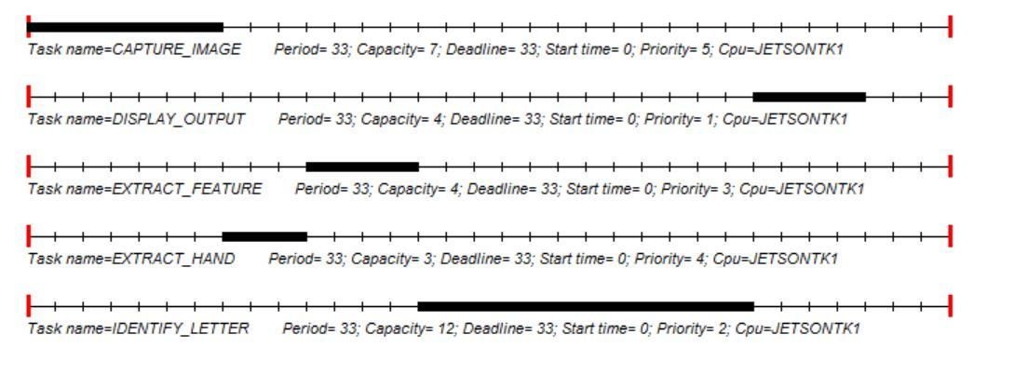
Feasibility analysis Cheddar & RM LUB
RM LUB = 0.909
The processor utilization exceeds the RM least upper bound.
Scaled down to fit in screen

Slide 16
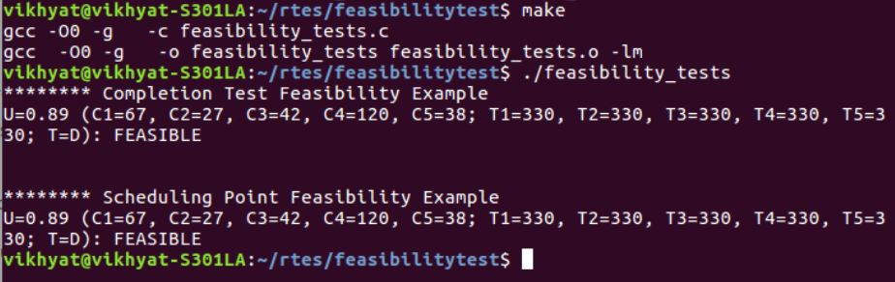
Schedule point & Completion test
The service was found to be feasible using schedule point and completion tests and agrees with the Cheddar analysis.

Slide 17
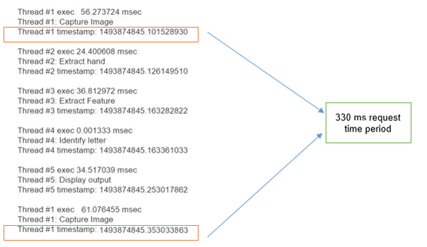
Time stamp tracing of services
Every thread should execute once with in the least common multiple of the time periods which is 330 ms.

Slide 18
Verification plan
Unit tests
Modules | Tests
Capture Image | Access camera | Flush buffer
Extract Hand | Background subtraction | Background reset
Extract Feature | Contour detection | Contour threshold
Identify Letter | Letter look up
Display output | Display matched letter
Training | Create reference image | Overwrite existing image

Slide 19
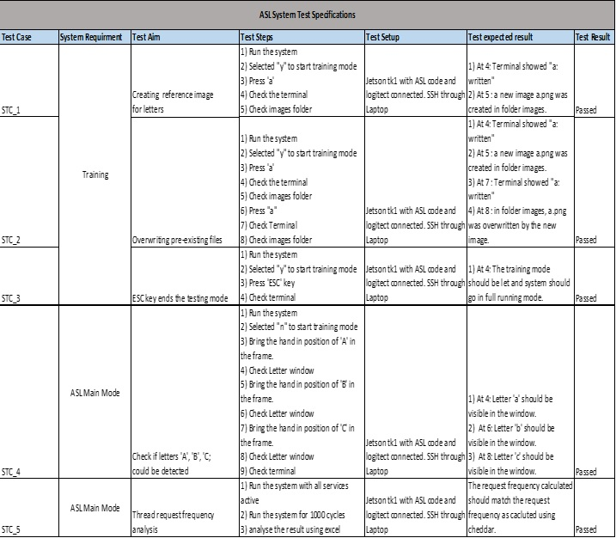
Verification plan
System tests

Slide 20
Future Scope
Making it universal. Since different parts of the world uses different sign language we can train our system and create a new database for different sign and make it usable for any sign language.
Interpret words and store it which later can be read to create a sentence.
The system can also be integrated with other devices which converts text to speech to increase its scope.
Use lightweight OS like FreeRTOS to improve execution efficiency and obtain quicker response.

Slide 21
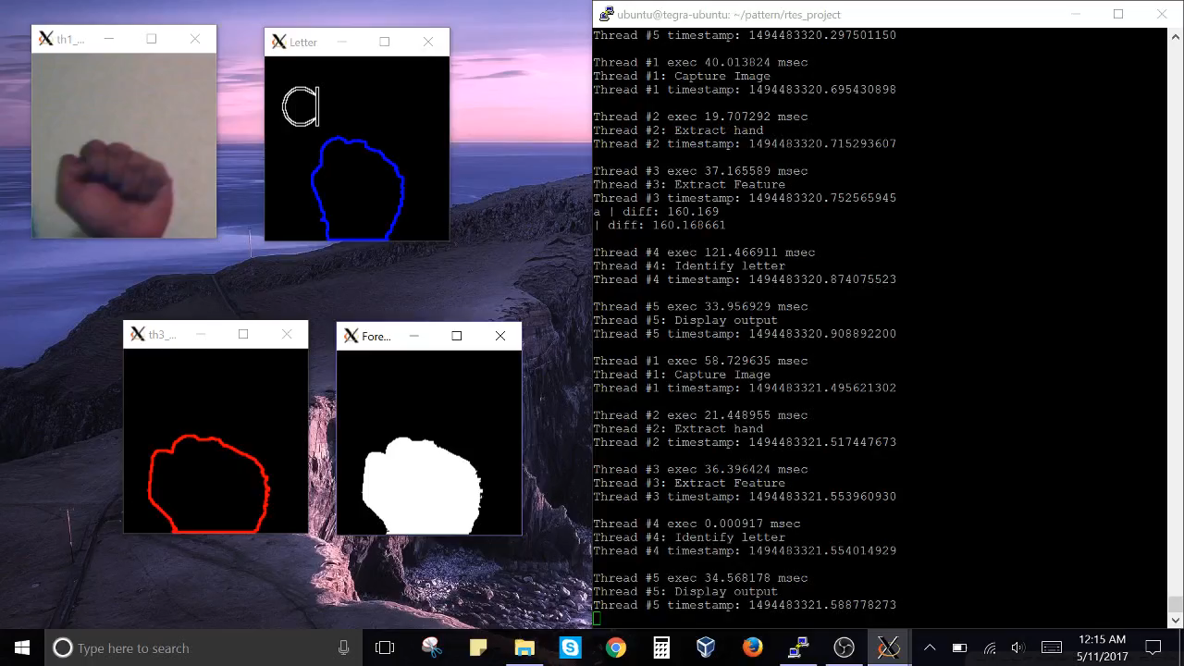
Video

Slide 22

Thank You.
Questions

